Slide 1
CS 4974 Independent Study
11/28/22 meeting
Student: Bug Lee

Slide 2
Last time, we discussed…
Wrapping up compiler
Project report
Fuzzer

Slide 3
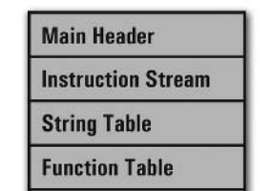
Week 8-13
Week 1-4
compiler
assembler
script.src
script.casm
script.exec
Week 5-7
Virtual Machine
CPU

Slide 4
What it can do
Preprocess Line // and block /* */ comments
“Typeless” language
Assignment, arithmetic, relational, and logical operations
Basic string processing
Static scoping using block
Array, where each array element can hold any type
Control flow (if/else)
Loop (while, for) and gotos (continue, break)
Function and return. Support both pass by value and pass by reference
Native functions (time, random, exit)

Slide 5
Demo

Slide 6
Benchmark Demo

Slide 7
Limitation
Cannot extend compiler to support initialize array size with variable due to current assembler/VM design
Compilation contains memory leaks. (Thankfully, no memory leak was found in virtual machine, so running executable is safe)
Ok syntax error message (show line number + error line + message),
But not so friendly semantic error message (only message)

Slide 8
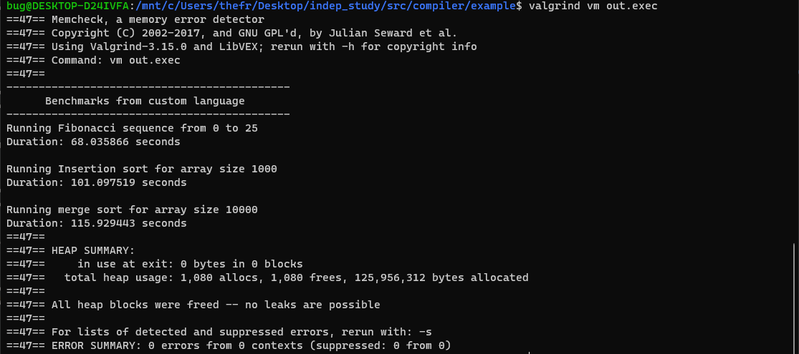

Slide 9
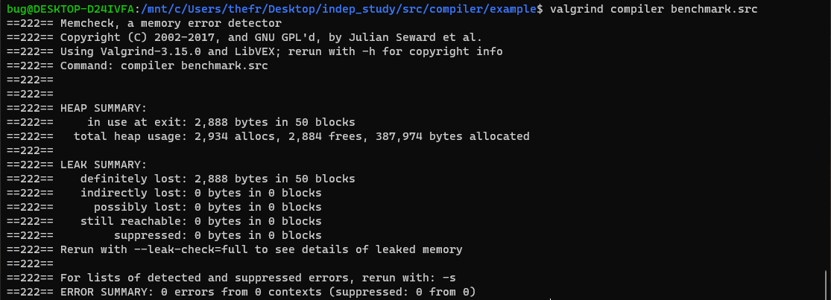

Slide 10
Future work
Better programmable language
Initializing array size with variable
Better mechanism for passing reference (eliminate the need of dereferencing)
Importing other source code
Friendlier error message
Optimization
Better code emitter
Redesign VM
Extra
Other language features like first-class, closure, object orientation, etc

Slide 11
Plan for week 14
Work on project report
Add more benchmark programs?
Work on Fuzzer
Learn about Docker?

